Slide 1
Meet JOY.
Open Enrollment 2022

Slide 2
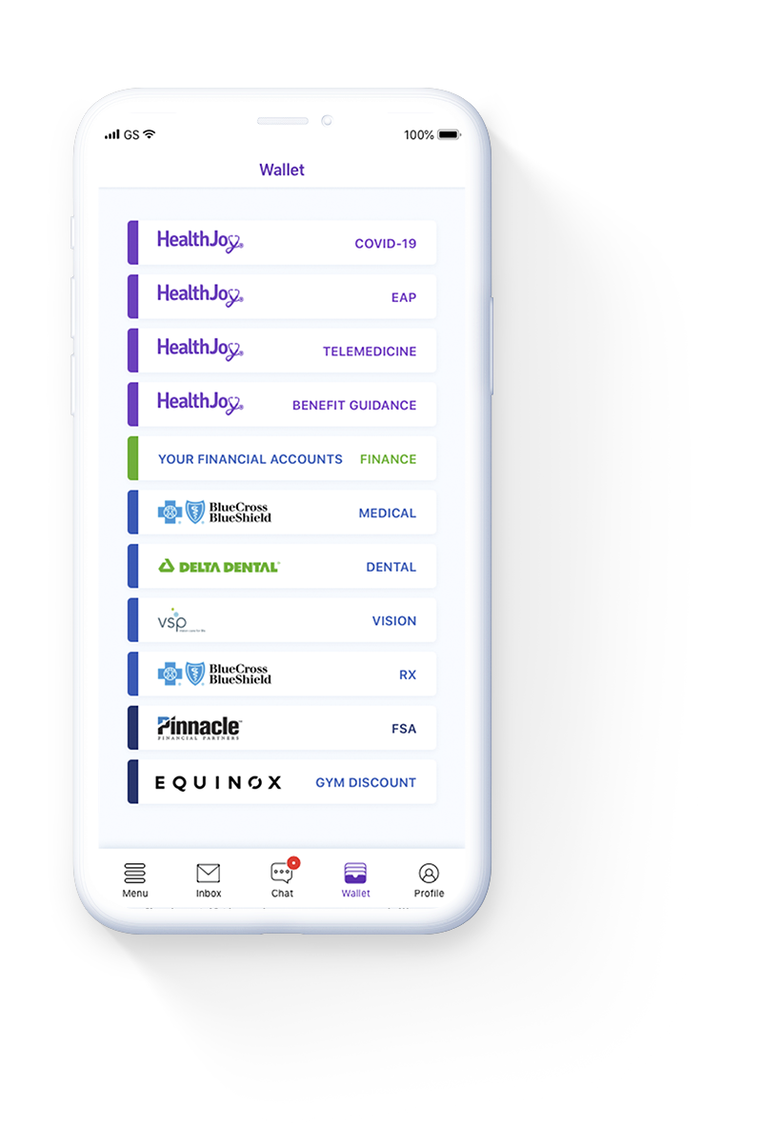
What is HealthJoy?
HealthJoy is our company’s healthcare navigation platform. It connects YOU to the right benefits at the right time to make it easier to be healthy and well.
Personalized Benefits Wallet
Provider Recommendations
Procedure and Facility Recommendations
Appointment Booking
Rx Savings Review

Slide 3
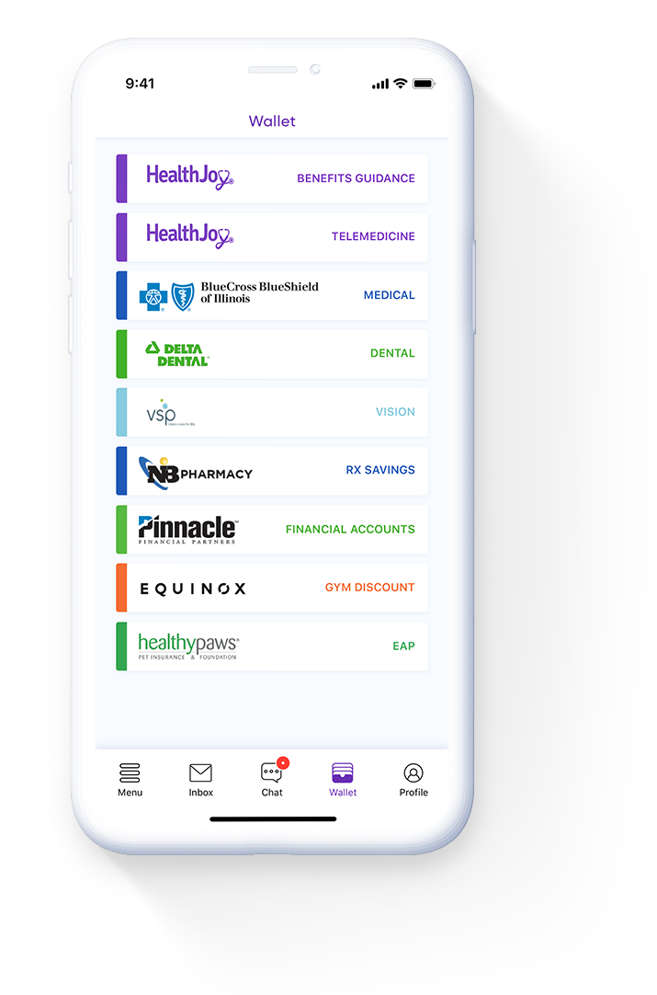
How Can HealthJoy Help You?
WHEN YOU ARE LEARNING ABOUT OUR BENEFITS
HealthJoy quickly familiarizes you with benefits through the digital benefits wallet
Navigate to the best healthcare providers using Find Care, or start a provider search
Adult spouses and dependents (18+) can use HealthJoy to access online medical consultations and mental health support
Rely on HealthJoy Rx Savings Review to find the lowest price on your family’s prescriptions
Use HealthJoy to track your 401k, HSA, and FSA balances

Slide 4
Member Stories
BILL REVIEW
Carah, a busy mom of two and marketing professional, was shocked when she was charged over $2,000 just minutes after exiting dental surgery.
Carah knew something was wrong, but she didn’t know how to fix it. So she immediately contacted HealthJoy’s Bill Review team.
By uncovering an insurance payment that wasn’t credited correctly to her account, the Bill Review team saved Carah $1,383.
“
“It’s just the best experience and such a huge weight lifted, especially in the middle of the COVID-19 pandemic when you’re watching every dollar being spent,” Carah said.

Slide 5
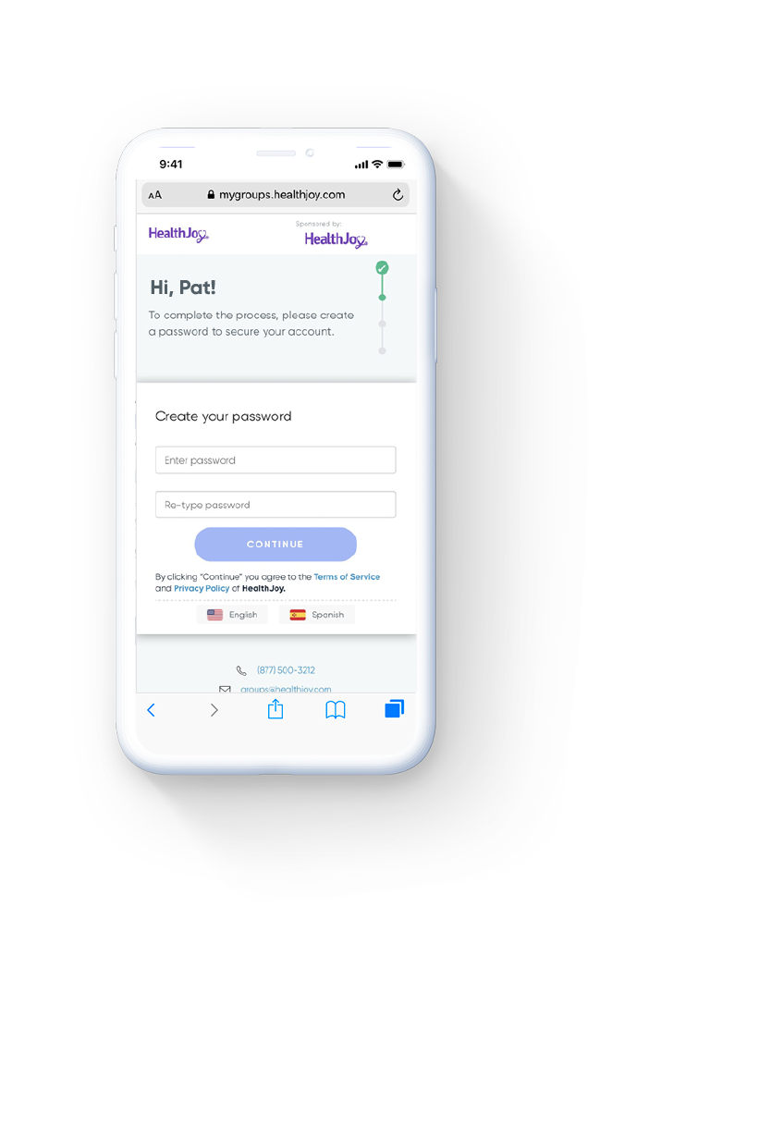
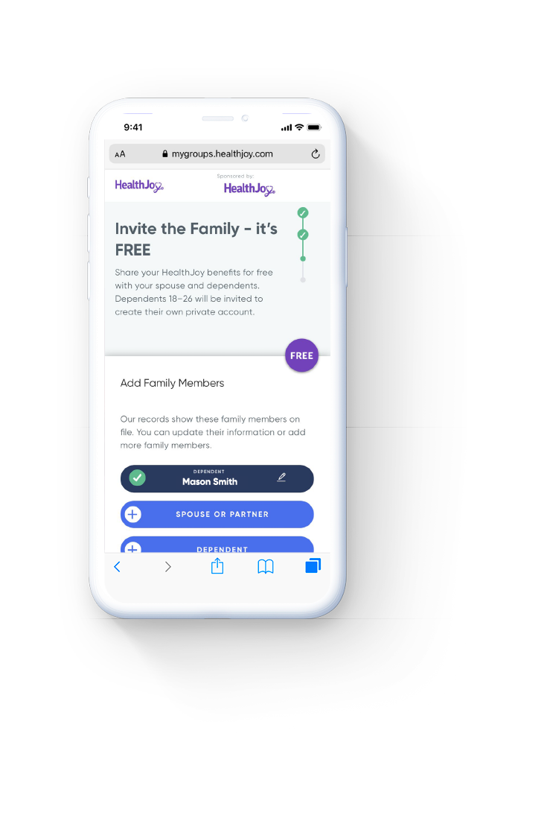
How Will You Use HealthJoy This Year?
To get started, download and activate HealthJoy when our benefits renew.

Slide 6
Resources
Member FAQs
https://healthjoy.com/faq/
How To Use HealthJoy Videos
https://healthjoy.com/educational-videos/

